Slide 1

Introduction to
FLUID COPLING

Slide 2
CONTENTS – FLUID COUPLING
Basic Principle
Structure
Feature
Operation Principle
Installation Method
Disassemble Method
Operation & Maintenance Manual
Trouble Reason & Countermeasure
Installed Photos

Slide 3
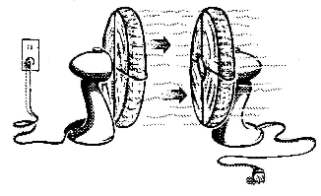
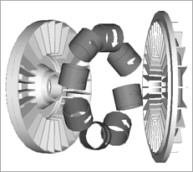
1. Basic Principle
► Basic Principle
1) Fluid couplings are developed by Dr. 훼팅거 at 1905 in German.
- Refer to Figure 1.
Two fans are facing each other and when one fan is operating, the other fan is turning.
- Refer to Figure 2.
The impellers are attached to the input side are arranged to face each other.
Fills the interior has a certain amount of oil as the power transmission medium.
The spinning impeller attached to the input side, the oil therein is a collision of the outer impeller wings by centrifugal force, and the kinetic energy is transfered.
<그림1>
<그림2>

Slide 4
1. Basic Principle
► Basic Principle
Since the power delivered by only the oil
without mechanical combination. so It does not
occur abrasion.
The transfer torque is determined by speed of
input side, oil amount and circuit's diameter.
Slip occurrence is essential to functioning of
the fluid, and can not be a power transmission
without slip.
Apply in Slip rate 1.5%~ 6% range.
<그림1>
Input speed–Output speed
Slip rate(%) =
X 100
Input speed
<그림2>

Slide 5
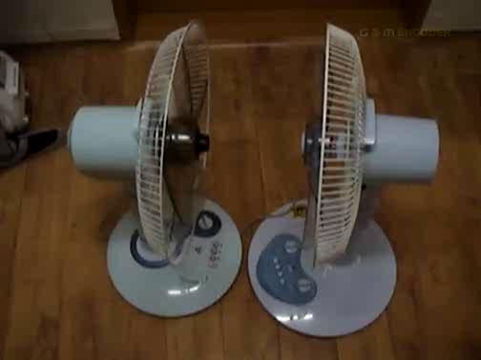
1. Basic Principle
► Video for Basic Principle
<화면클릭시 재생됩니다.>

Slide 6
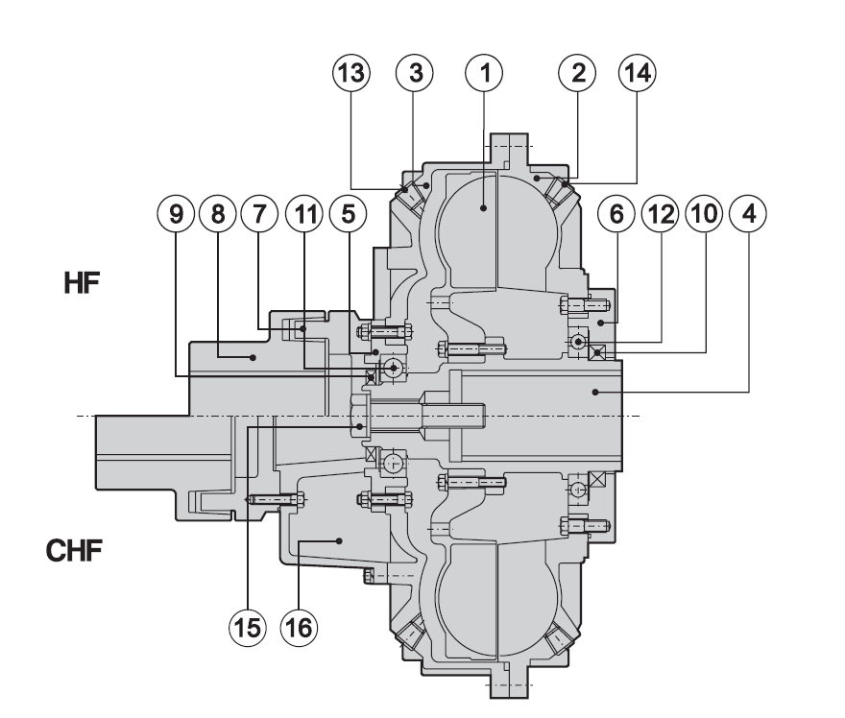
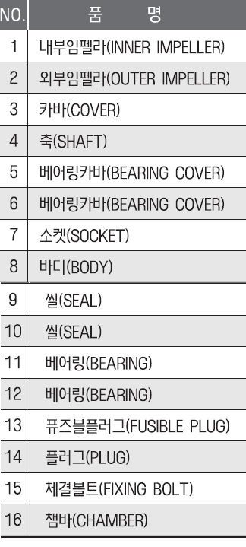
2. Structure (HF, CHF)

Slide 7
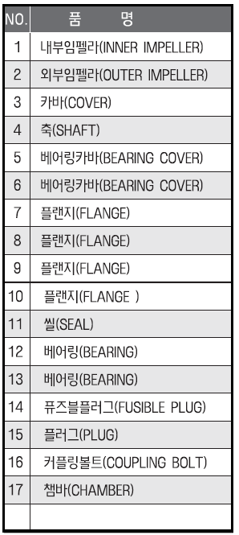
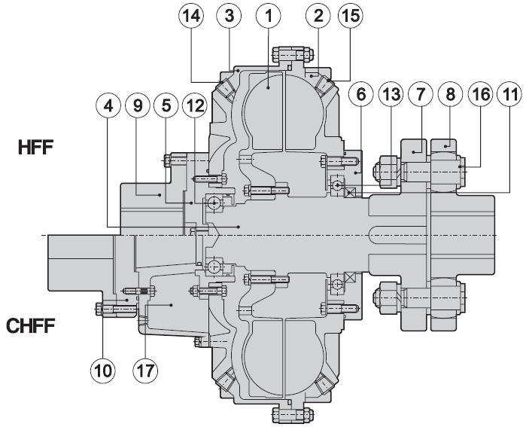
2. Structure (HFF, CHFF)

Slide 8
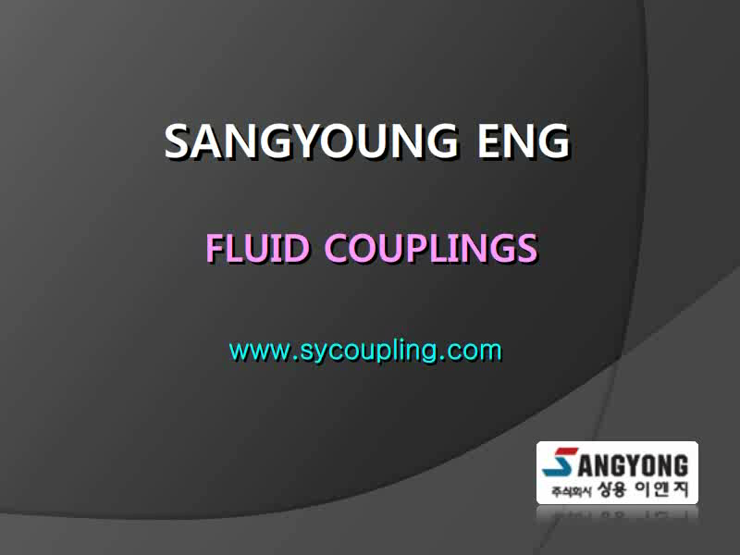
2. Structure (CHF Disassemble)
<화면클릭시 재생됩니다.>

Slide 9
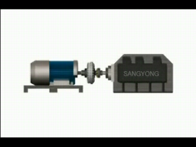
2. Structure (HFF Video)
<화면클릭시 재생됩니다.>

Slide 10
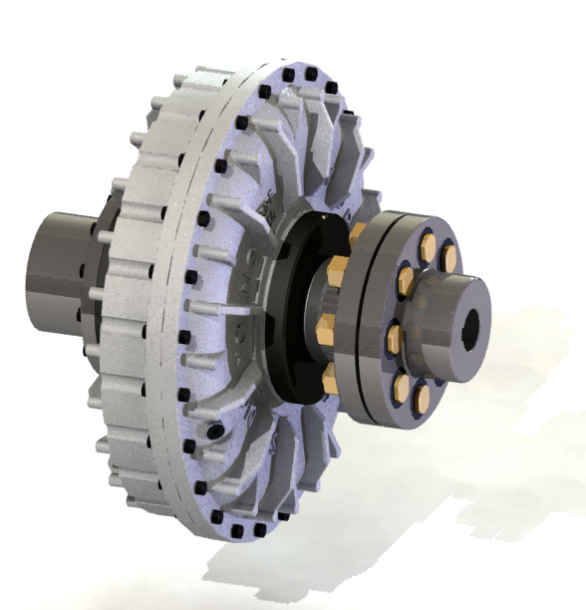
3. Feature
Fluid coupling | Features
 | 1) Standard type When occuring shock loading, Fluid coupling can protect Motors and driven equipment. Because there is no mechanical connection. Using general motors instead of expensive special motors. - Reverse rotation is possible to stop the driven. 2) Chamber type Fluid couplings can control starting torque to prevent damage to the belt of conveyor belt.

Slide 11
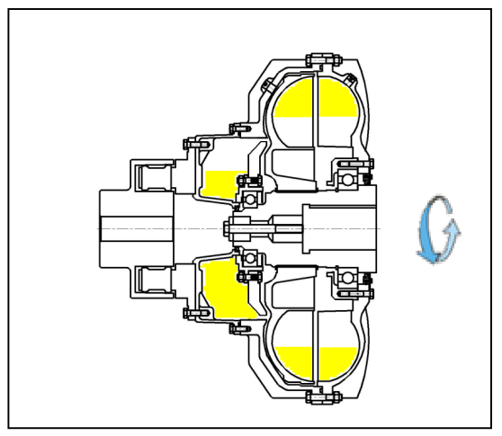
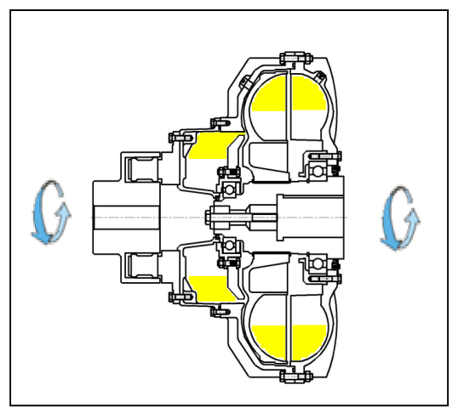
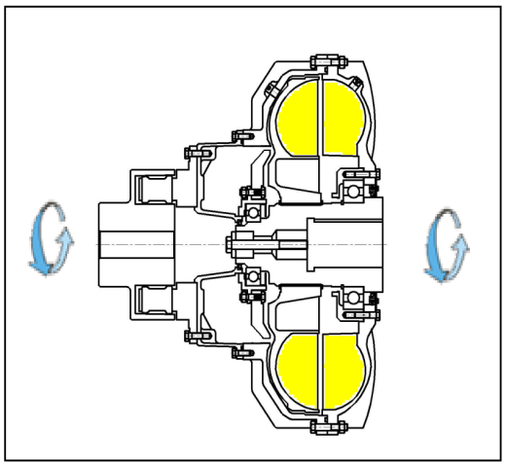
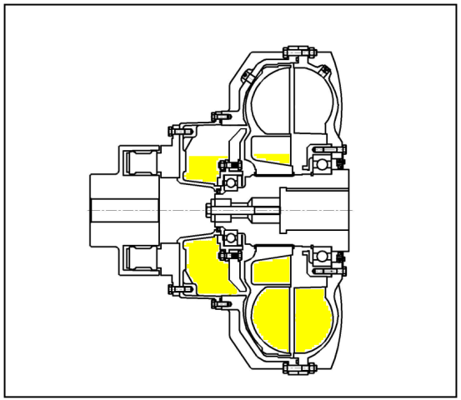
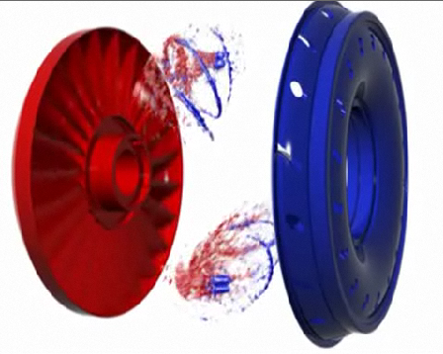
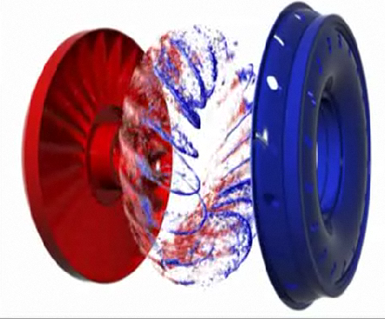
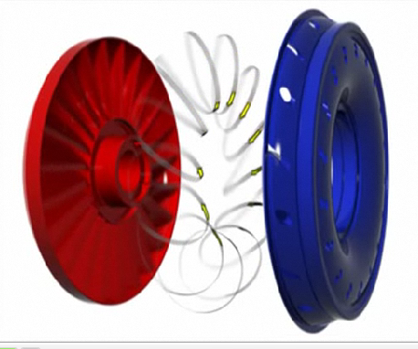
4. Operation Principle
0 1800
450 1800
1760 1800
0 0
► Flow changes after starting
► STOP

Slide 12
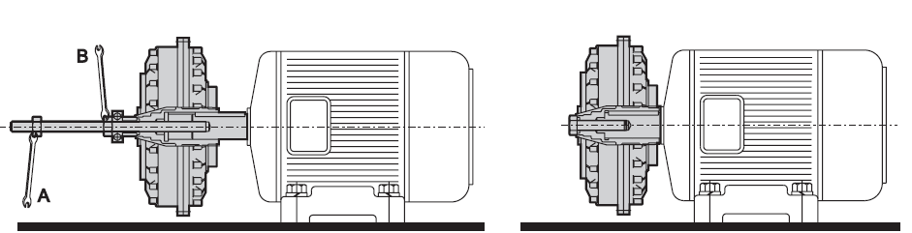
5. Installation (HF, HS, HP)
► Fluid coupling is mounted on motor shaft using 2 spanners with screws.
► Prohibit shrinkage fitting in order to prevent damage of inside Seal.
► Axis machining requires TAP.
► For safety and long life of the equipment to fit eccentricity,
declination and the gap.

Slide 13
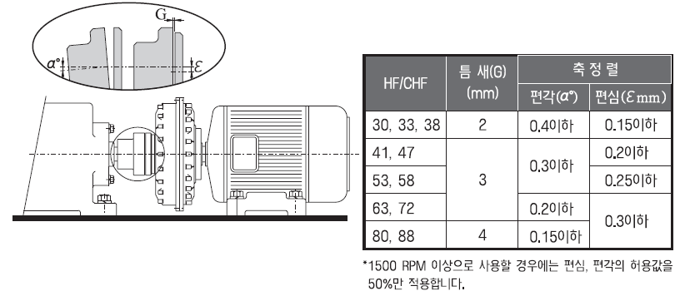
5. Installation (alignment)
► Install eccentricity, declination
and gap in accordance with
below table.
► In case of using at the equipment of
more than 1500rpm, apply only 50% of
eccentricity and declination. .

Slide 14
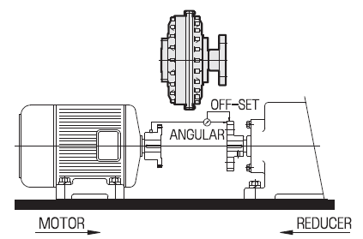
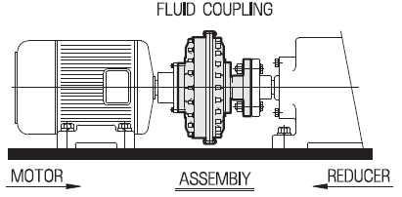
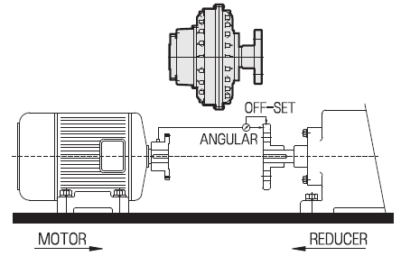
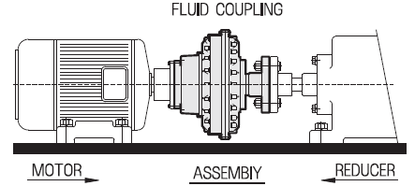
5. Installation (HFF, HG)
1) HFF - TYPE
2) CHHF - TYPE
► At HFF & CHFF Type, Flange coupling and Flange are installed at MOTOR
side and associated machine.
► Must be injected into oil or grease at the contact surfaces for the correct installation.
► Pay attention to may cause damage to Flange of Flange coupling when shrink fitting.

Slide 15
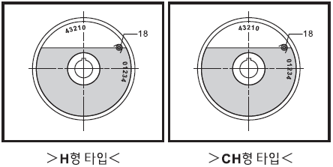
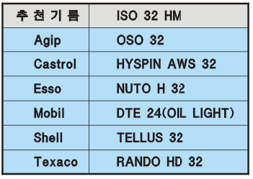
5. Installation (Injection of Oil)
► After installation the casing is rotating
for facing up.
► At first lightly fixed coupling, and open
the opposite plug to be pulled out of
the air inside the circuit.
And inject oil until it overflows out of
the oil inlet.
► Loctite is pasted to the plug to
prevent leakage oil during
operation. .
► If you do not know the injection point.
standard (H-type)“0”
Chamber type (CH-type)“2 ”

Slide 16
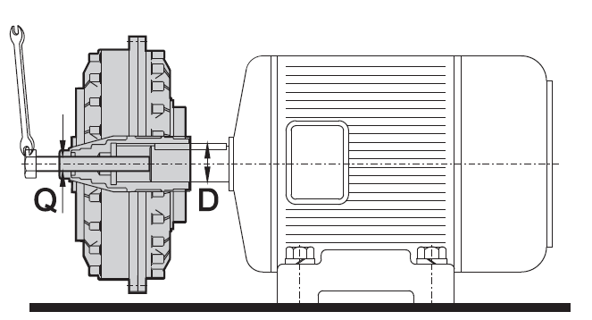
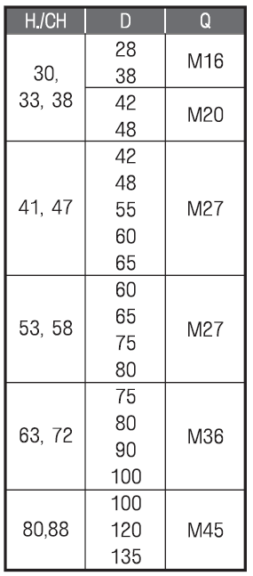
6. Disassemble
► First, you must remove the oil pulling
plugs on the both sides.
► Disassemble FIXING SCREW.
► Disassemble the bolt assembly from
Fluid coupling.
► Disassemble Fluid coupling by shaft using a jig.
Refer to table beside.
► Don't hit the bolts and the body of the fluid coupling by
hammer during disassemble.

Slide 17
7. Operation & Maintenance
► If frequent movement does not exceed the maximum exothermic
temperature is 90 °.
► If you want to operate at a higher temperature conditions, please contact us.
► Excessive heat causes
- Lack of oil
- Driven machine' power is higher than rated power of the motor.
- Ambient temperature is too high or The long start-up time.
► After 20days from the initial operation you check oil amount and locked state of
fixing bolt.
.
► Periodically check Shaft alignment of Fluid coupling.
► Fusible plug is 145 ° is standard.
please contact us if you need Fusible plug for 175 ° or 120 °
► Replace the oil at about 4000 hours of operation.

Slide 18
8. Trouble Reason & Countermeasure
Trouble | Trouble Reason | Countermeasure
Oil leaking | Seal damage by dirty oil. shrinkage fitting when assembling the input side. | Seal Replacement
Fluid coupling overheating | Unsuitable standard selection. Lack of oil amount. Overload. | Selecting suitable standard. Oil supplement. Remove overload causes.
Fluid coupling noise & vibration | Bearing damage. Unfit Centering. Poor of driving part’s bed. | Bearing replacement. Re-centering. Bed drive reinforcement.
► Please contact the manufacturer for overhaul of Fluid couplings. .

Slide 19


Application of Fluid couplings
< Steel material Bucket in POSCO >
< Coal material Bucket in
TAEAN Thermal Power Plant >

Slide 20

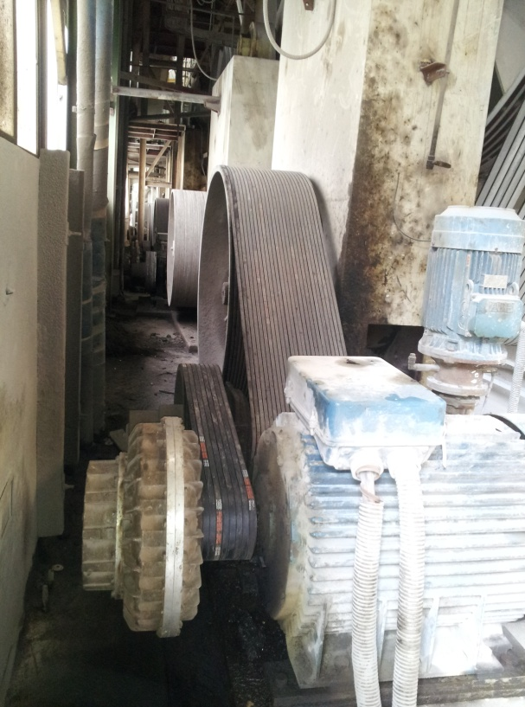
Application of Fluid couplings
<TAEAN Thermal Power Plant>
<Tile manufacturer>

Slide 21

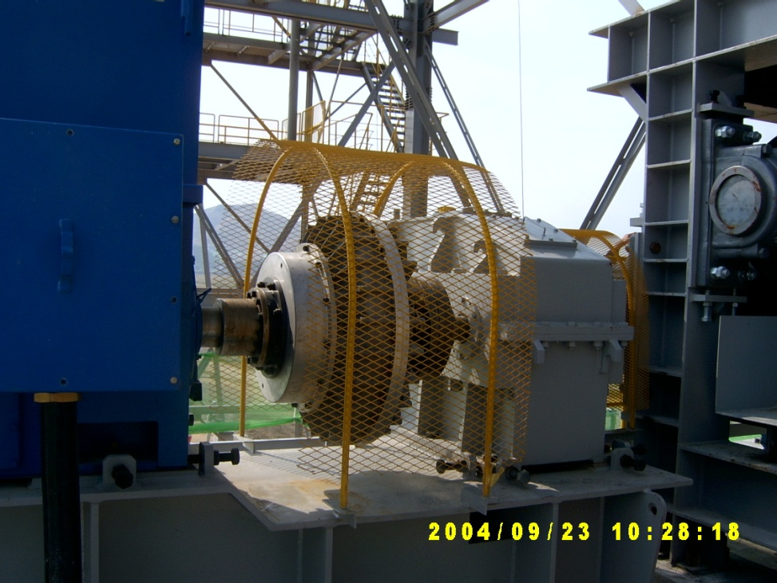
Application of Fluid couplings
<Incheon airport 5#>
<Incheon airport 2#>

Slide 22
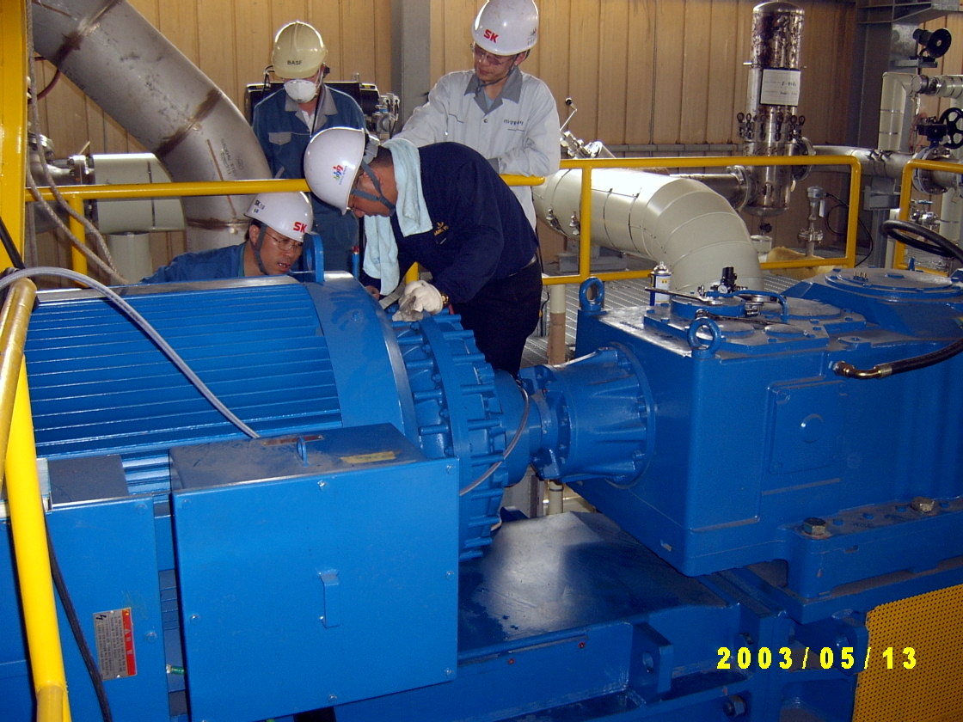
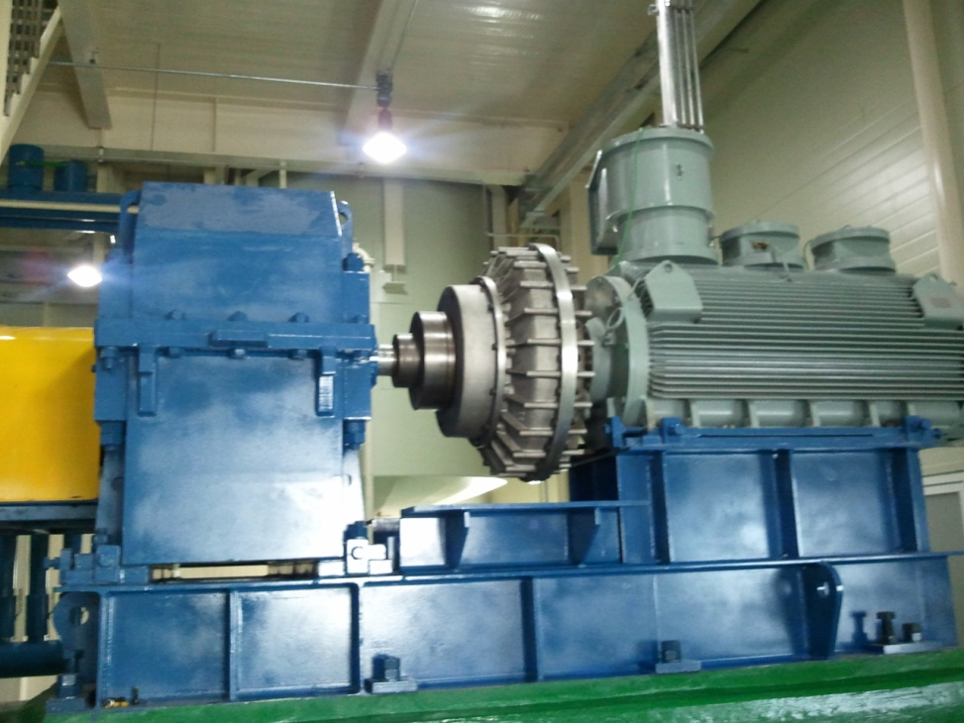
Application of Fluid couplings
<Agitator for vitamin material in BASF>
<Agitator>

Slide 23


Application of Fluid couplings
<Tower Crane>

Slide 24


Application of Fluid couplings
<Lift in Ski resort>

Slide 25
ขอบพระคุณครับ

